Slide 1


Data Analysis into US Higher Education Affordability Crisis
◤
By: Anna Brunner, LeChae Mottley, & Thomas Reinhart

Slide 2

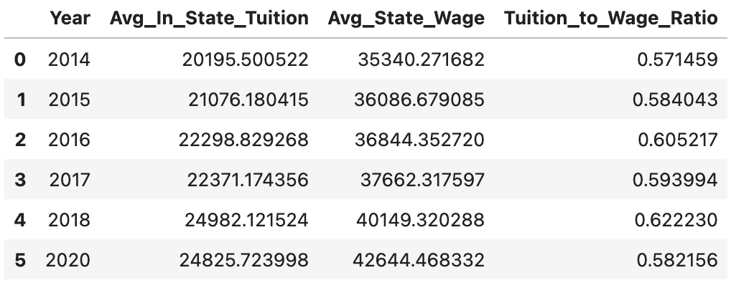
Tuition Growth vs Wage Growth
◤
Average in-state tuition increased ~23% from 2014–2020
Median state wages increased ~21% in the same period
Tuition represents ~58–62% of the average annual wage
Indicates growing affordability pressure for families

Slide 3
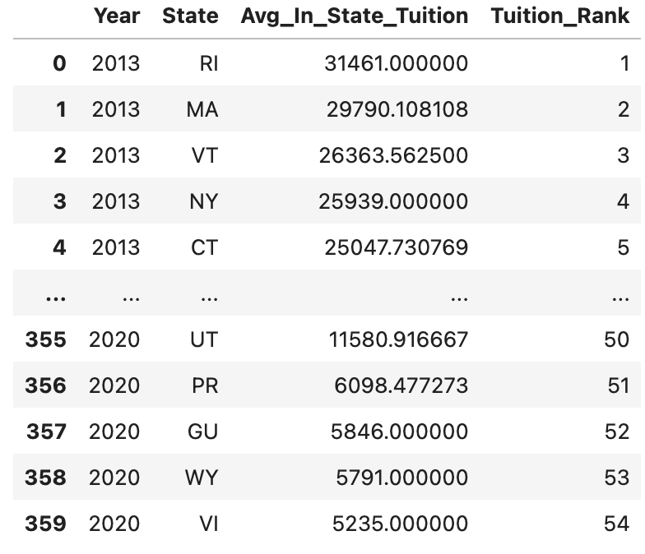
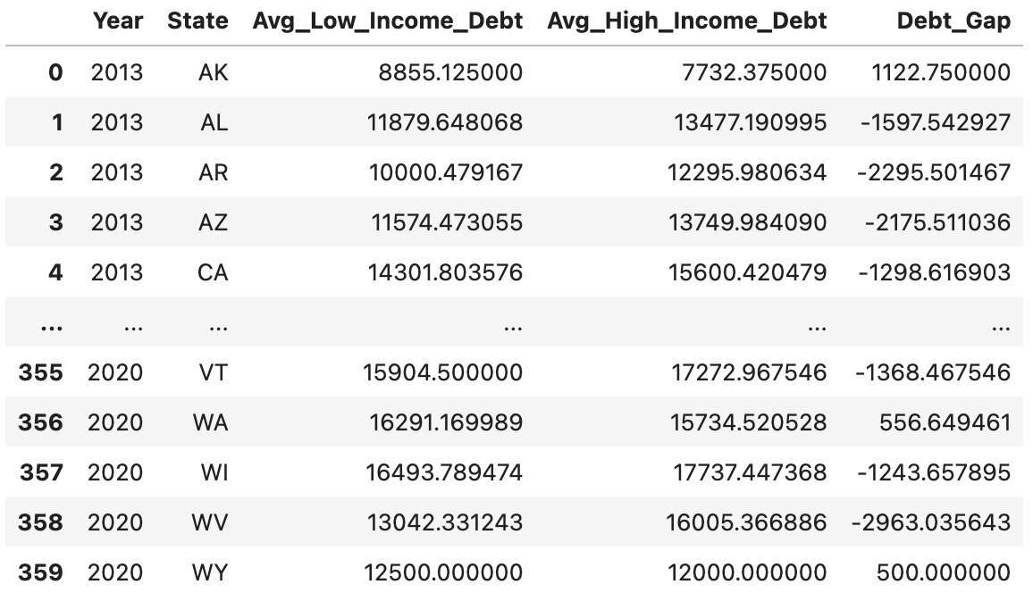
Variation Across States and Institutions
◤
Tuition levels differ substantially across states
Higher-cost states often show larger debt burdens
Institutional pricing and geography strongly influence affordability outcomes

Slide 4
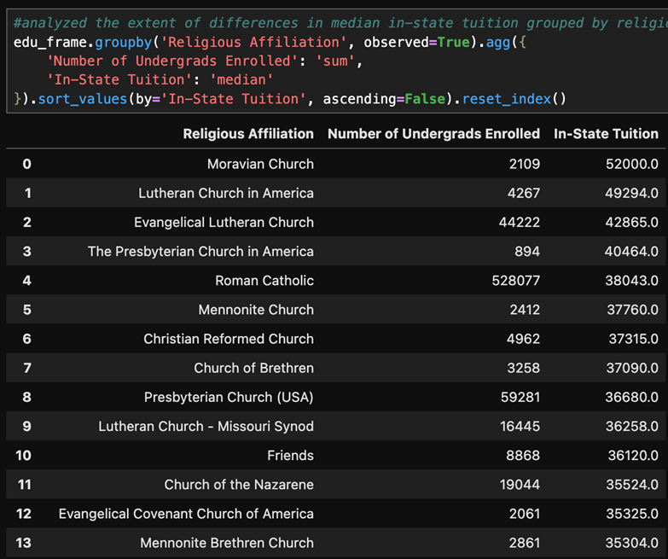
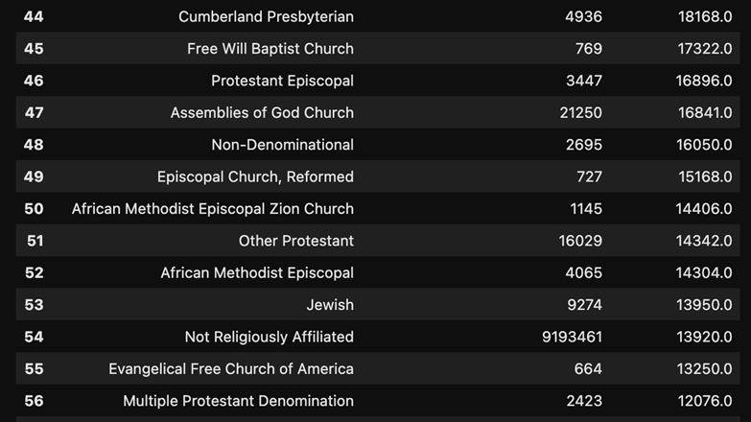
Median In-State Tuition Grouped By Religious Affiliation
◤

Slide 5
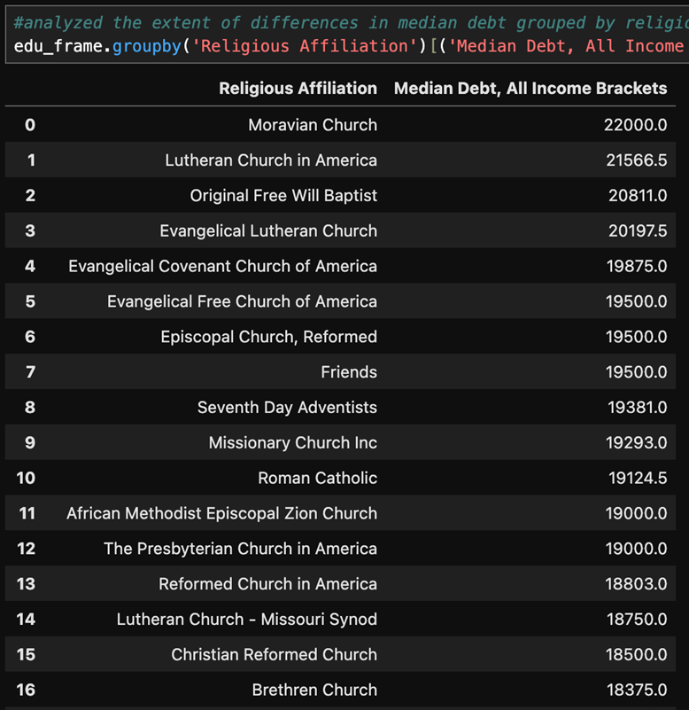
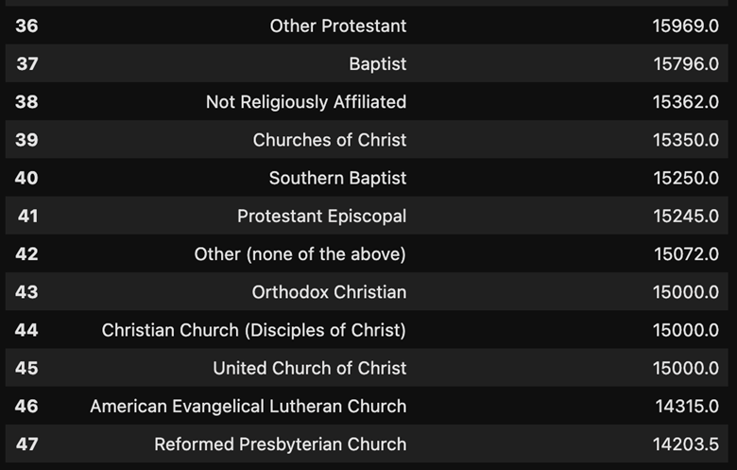
Median Student Debt Grouped By Religious Affiliation
◤

Slide 6
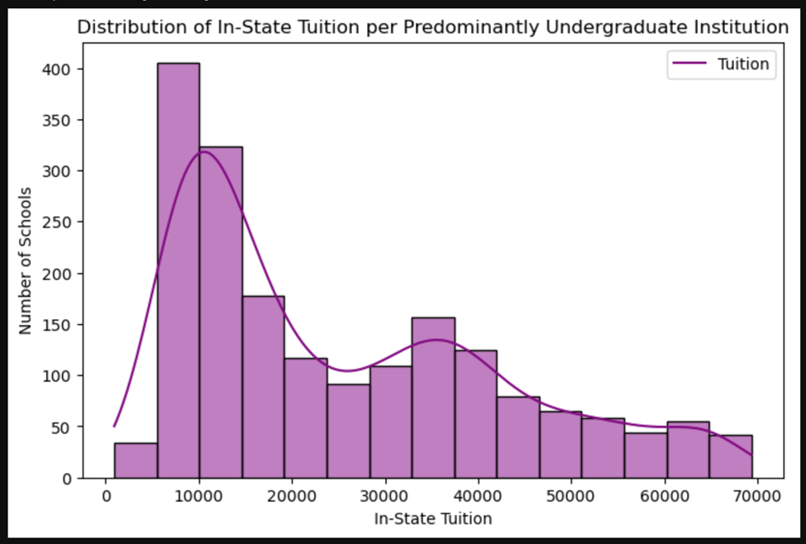
Distribution of In-State Tuition
◤

Slide 7
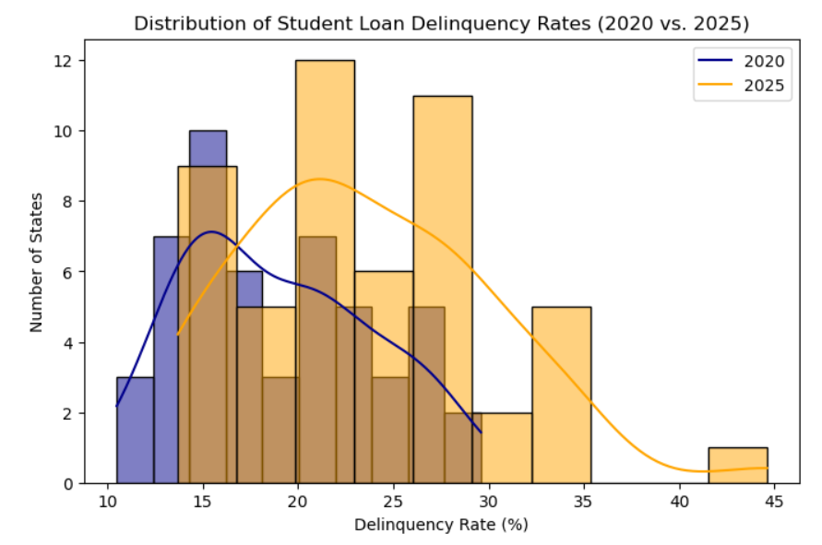
Distribution of Student Loan Delinquency Rates
◤

Slide 8
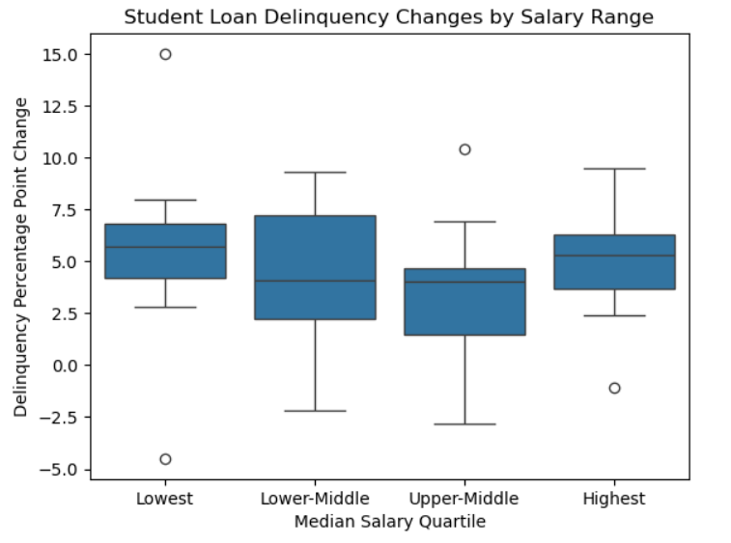
Distribution of Student Loan Delinquency Rates by Salary
◤

